Slide 1
Heart Dissection

Slide 2
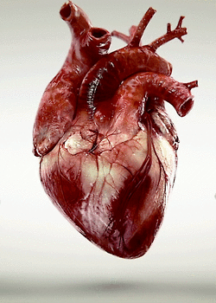
The heart is the motor of the circulatory system.
The heart muscle contracts and pumps deoxygenated blood (low in oxygen from cell usage) directly into the lungs where it becomes oxygenated (oxygen-rich). From here, it returns to the heart to be transported throughout the body.

Slide 3
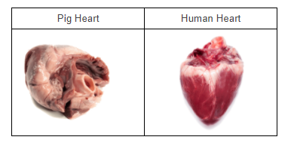
Pig or sheep hearts are often used to study the anatomy of human hearts because they are very similar in structure and size.
They also have a very similar function to human hearts, which makes them a good candidate for a heart dissection investigation.

Slide 4
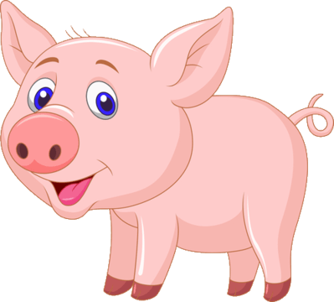
During this investigation you are going to learn how the heart's structure relates to its function by dissecting a pig's heart!
Told you it wasn't for the faint-hearted! Let's get stuck in!

Slide 5

Before we get started, let's talk about safety!
This investigation uses some harmful tools that you need to know about.
These are a scalpel, scissors and tweezers.

Slide 6
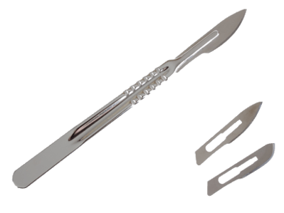
You will be using a scalpel in this investigation. This is a small knife with a very sharp, sometimes detachable blade.
These must be used in an appropriate and safe manner.

Slide 7
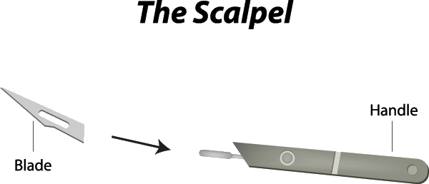
Be EXTREMELY careful when applying and removing the disposable blade on the scalpel.
• | Make sure you are facing away from people when doing this.
• | When removing the blade, do not apply huge amounts of pressure. It should just click and slide off.
• | When finished, dispose of it in the sharp wastes bin.

Slide 8
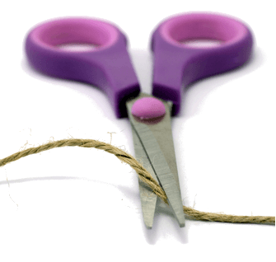
Scissors, just like scalpels, are very sharp! The same care and caution needs to be taken when handling them.
• | Always hold them from the handles and never the blade.
• | Always cut AWAY from your body.
• | Never point them at anyone else.
• | You should have no reason to carry them anywhere but if you do, WALK with them, with the blades facing the floor.

Slide 9
You might laugh, but tweezers too have the potential to cause harm. Look how pointy and sharp they are in the picture on the right! Just like using scissors, the same care and caution needs to be taken when using them.

Slide 10
That's it for safety!
Just remember, if anything happens, tell your teacher.
They will know what to do.

Slide 11
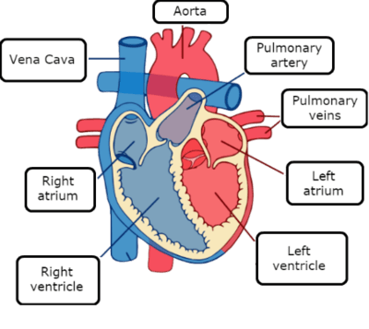
Spend a good 5 minutes looking at your heart. During this time, see if you can identify the main blood vessels:
• | The aorta
• | The pulmonary veins
• | The vena cava

Slide 12
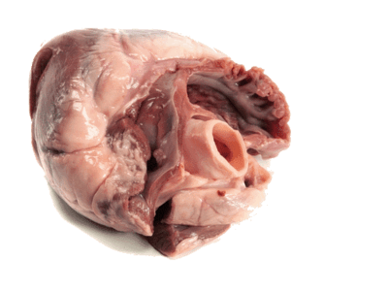
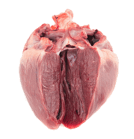
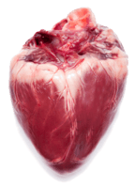
The next step is to go and observe the rest of your classmates' pig or sheep hearts. There will be some hearts that are bigger than others, some covered in more fatty tissues than others and some maybe even containing cancerous lumps.
Record any observations.

Slide 13
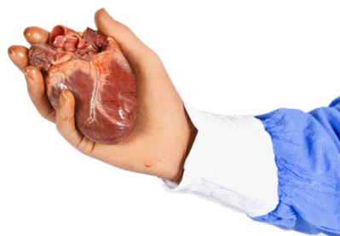
Let's compare the left and right sides of the heart. You do this by squeezing each half of the heart.

Slide 14
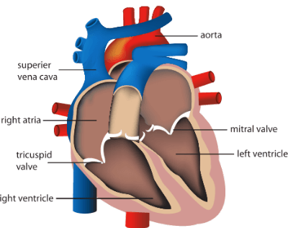
By now, you should have identified where the main vessels are.
Here's the fun part!
Push your finger all the way in the aorta and you will feel the inside of the left ventricle. You should notice that the left ventricle has a very thick wall, unlike the right ventricle.
Use the image below for guidance.

Slide 15
Next, insert your finger through the pulmonary artery to feel the right ventricle and you should notice and feel that it is much thinner than the left side of the heart.
Use the image below for guidance:

Slide 16
Copy the table below into your textbook. Tick off the structures as you find them and write down your observations.
Structure | Find it? (X or √) | Observations
Right atrium
Left atrium
Right ventricle
Left ventricle
Aorta
Vena cava
Pulmonary veins
Pulmonary artery

Slide 17


